Slide 1
IaRT – CHECKPOINT 1
Daniel Brandão – 201705812
Pedro Moás – 201705208
Gaspar Pinheiro - 201704700

Slide 2
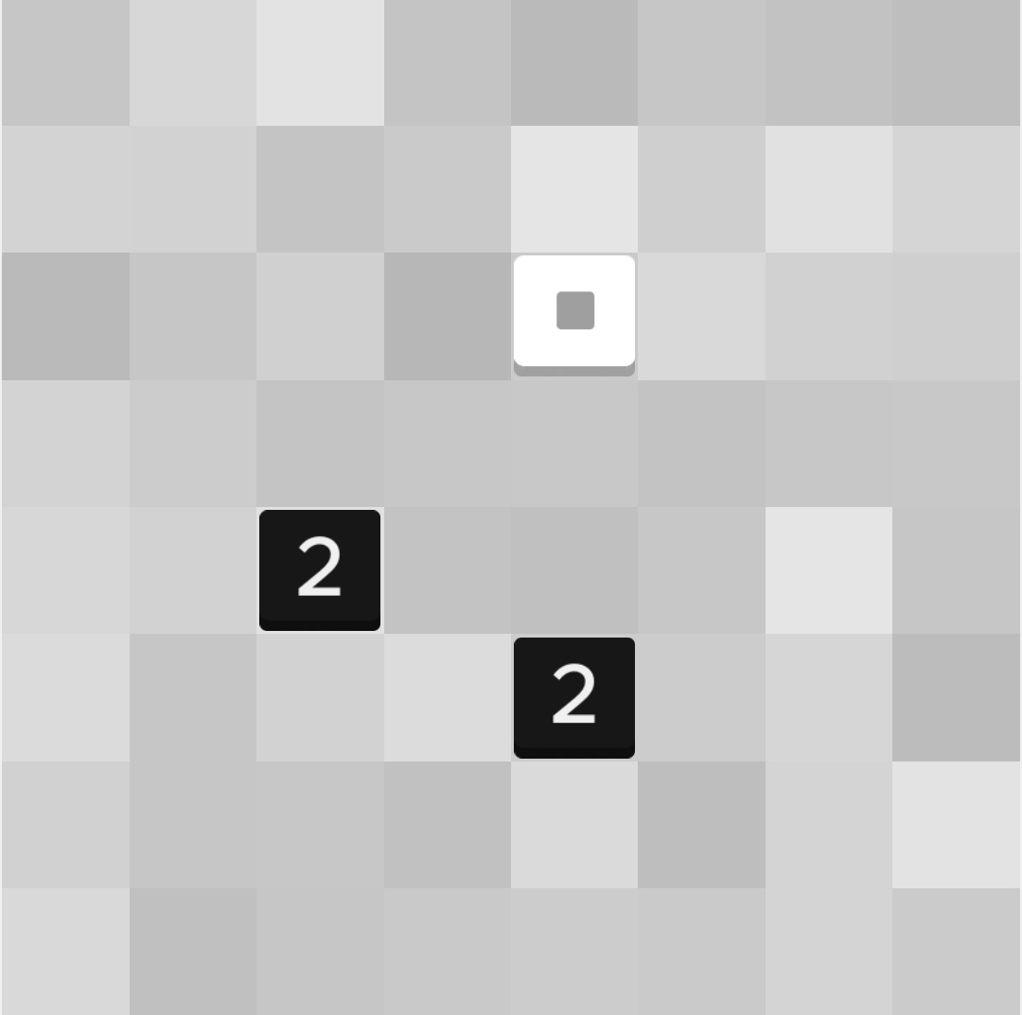
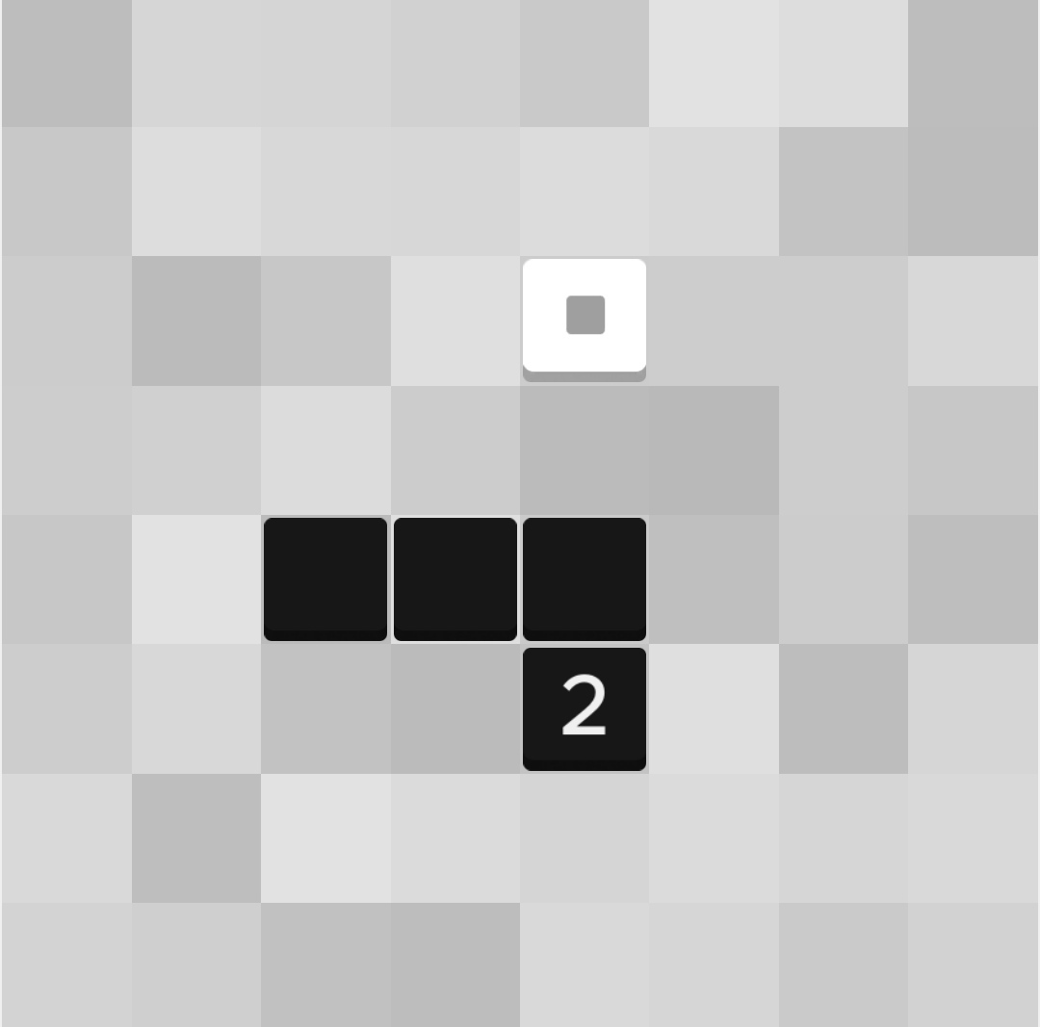
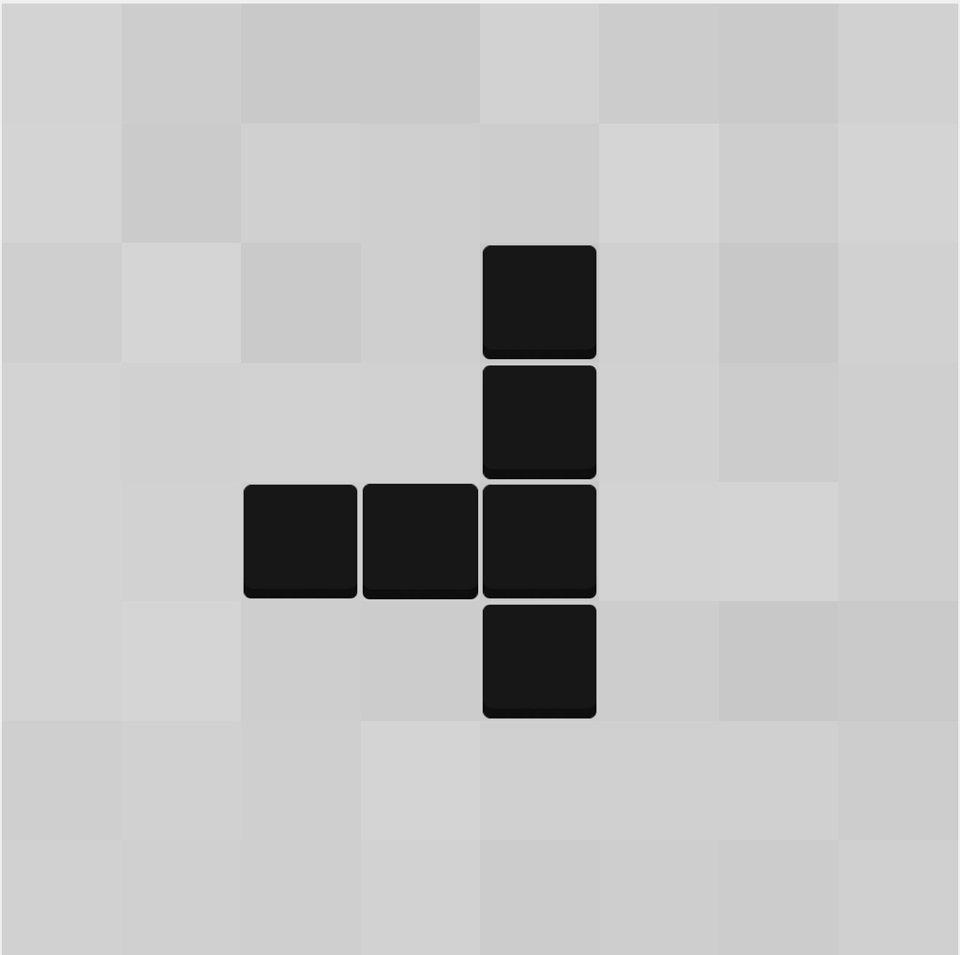
ZHED - Single Player Game
ZHED is grid based puzzle game where in order to complete each level a numbered cell must be expanded to reach the goal cell.
Each numbered cell can be expanded in one of four directions and overlapped. Each cell expands n cells in the direction chosen, decreasing by one for each empty cell. When a expanding cell overlaps an already filled cell, the number of cells to be filled in the direction of the expansion is not decreased.

Slide 3
Pesquisa relativa ao nosso projeto

Slide 4
Formulação do Problema

Slide 5
Trabalho desenvolvido

